Slide 1
Tutorial 2
Selection of camera for specific vision based application

Slide 2
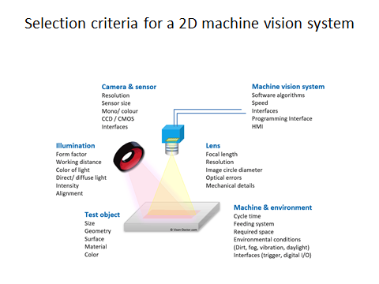

Slide 3
Application for vision based automation
Detection of cereal and snack labs
Detection of leakages in pipeline using Drone Camera
Vision Guided Robots

Slide 4
Camera Sensor Database
https://www.vision-doctor.com/en/camera-sensor-database.html

Slide 5
Lens calculator - Online tools for optical calculations
https://www.vision-doctor.com/en/optical-calculations.html

Slide 6
Online camera calculations
https://www.vision-doctor.com/en/camera-calculations.html

Slide 7
Interface calculations
https://www.vision-doctor.com/en/camera-calculations.html

Slide 8
Illumination Calculation
https://www.vision-doctor.com/en/illumination-calculations.html

Slide 9
Vision System Calculation
https://www.vision-doctor.com/en/vision-system-calculations.html

